Slide 1


Aaratrika Santra
09.05.2023

Slide 2

Outline
Executive Summary
Introduction
Methodology
Results
Conclusion
Appendix

Slide 3
Executive Summary
Summary of methodologies
SpaceX Data Collection using SpaceX API
SpaceX Data Collection with Web Scraping
SpaceX Data Wrangling
SpaceX Exploratory Data Analysis using SQL
Space-X EDA DataViz Using Python Pandas and Matplotlib
Space-X Launch Sites Analysis with Folium
Interactive Visual Analytics and Ploty Dash
SpaceX Machine Learning Landing Prediction
Summary of all results
EDA results
Interactive Visual Analytics and Dashboards
Predictive Analysis

Slide 4
Introduction
Project background and context
SpaceX advertises Falcon 9 rocket launches on its website with a cost of 62 million dollars; other providers cost upward of 165 million dollars each, much of the savings is because SpaceX can reuse the first stage. Therefore if we can determine if the first stage will land, we can determine the cost of a launch. We train a machine learning model to try and predict the landing outcomes based on previous data.
Problems you want to find answers
We will try predict if the Falcon 9 first stage will land successfully using data from Falcon 9 rocket launches advertised on its website.

Slide 5

Section 1

Slide 6
Methodology
Executive Summary
Data collection methodology:
Data was first collected using SpaceX API (REST API) by making a get request to the SpaceX API.
Perform data wrangling
To make JSON results more consistent, the SpaceX launch data was requested and parsed using the GET request and was then converted to Pandas dataframe.
Perform exploratory data analysis (EDA) using visualization and SQL
Perform interactive visual analytics using Folium and Plotly Dash
Perform predictive analysis using classification models

Slide 7
Data Collection
Working with SpaceX launch data that is gathered from an API, specifically the SpaceX REST API.
This API gives us data about launches, including information about the rocket used, payload delivered, launch specifications, landing specifications, and landing outcome.
Our goal is to use this data to predict whether SpaceX will attempt to land successfully and then in extension reuse the first stage of launch again to make it more economical.
To make the requested JSON results more consistent, the SpaceX launch data was requested and parsed using the GET request and then decoded the response content as a Json result which was then converted into a Pandas data frame.
After that we implemented web scraping to collect Falcon 9 historical launch records from a Wikipedia page titled List of Falcon 9 and Falcon Heavy launches of the launch records are stored in a HTML.

Slide 8
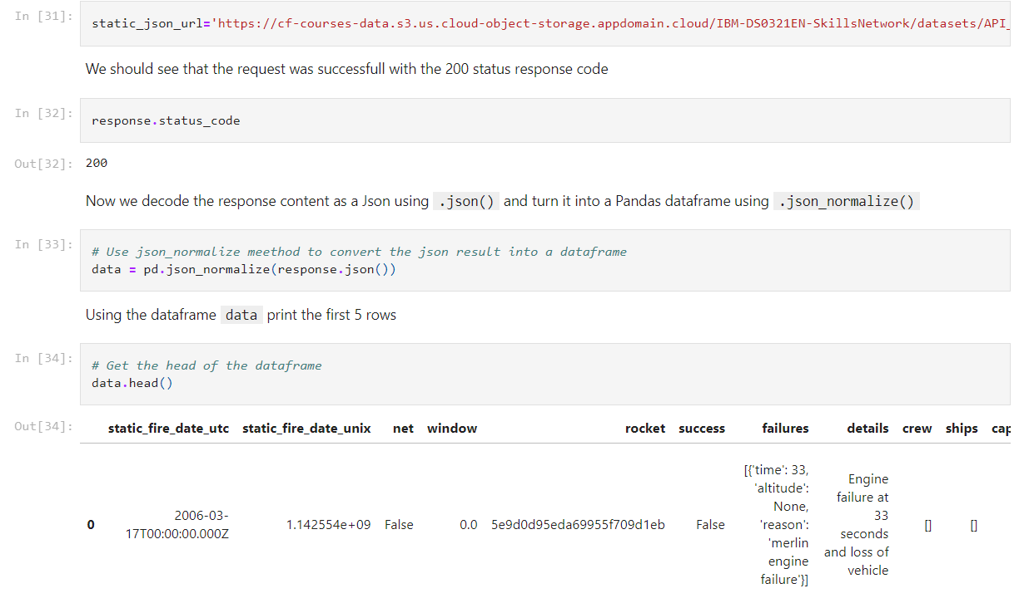
Data Collection – SpaceX API
Data collected using SpaceX API (REST API) by making a get request to the SpaceX API then parsing the data using the GET request and decoding the response content as a Json then converted into a Pandas data frame.
Github link: https://github.com/AaratrikaSantra/Applied_Data_Science_Capstone/blob/main/1.%20SpaceX%20Falcon%209%20first%20stage%20Landing%20Prediction.ipynb
Place your flowchart of SpaceX API calls here

Slide 9
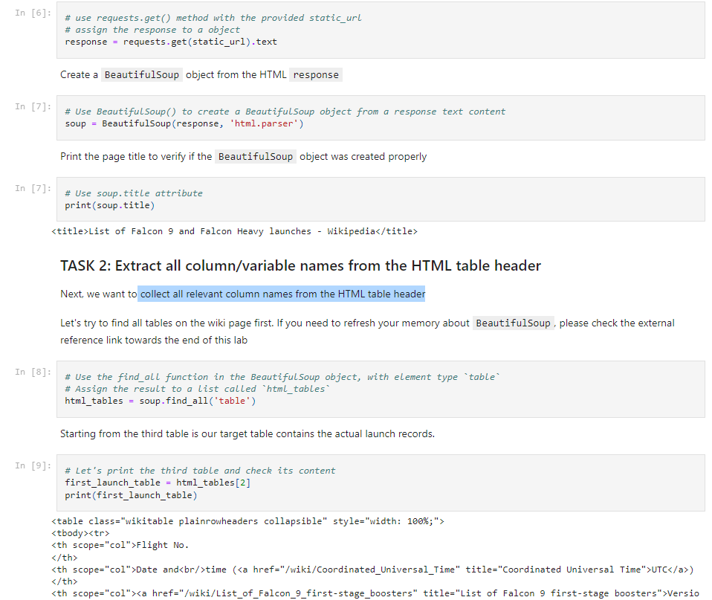
Data Collection - Scraping
Web Scrapping to collect Falcon 9 historical launch records from Wikipedia page. We HTTP GET method to request the Falcon9 Launch HTML page, as an HTTP response. We collect all relevant column names from the HTML table header and creating a dataframe by parsing the launch HTML tables
Github link: https://github.com/AaratrikaSantra/Applied_Data_Science_Capstone/blob/main/2.%20Web%20scraping%20Falcon%209%20and%20Falcon%20Heavy%20Launches%20Records%20from%20Wikipedia.ipynb
Place your flowchart of web scraping here

Slide 10
Data Wrangling
Exploratory Data Analysis (EDA) to find some patterns in the data and determine what would be the label for training supervised models.
Convert those outcomes into training Labels with 1 meaning the booster landed successfully and 0 means that it landed unsuccessfully.
Data was filtered using the BoosterVersion column to only keep the Falcon 9 launches, then dealt with the missing data values in the LandingPad and PayloadMass columns
Github link: https://github.com/AaratrikaSantra/Applied_Data_Science_Capstone/blob/main/3.%20Data%20Wrangling%20Space%20X%20Falcon%209%20First%20Stage%20Landing%20Prediction.ipynb

Slide 11
EDA with Data Visualization
• Performed data Analysis and Feature Engineering using Pandas and Matplotlib.i.e.
• Exploratory Data Analysis
• Preparing Data Feature Engineering
• Used scatter plots to Visualize the relationship between Flight Number and Launch Site, Payload and Launch Site, FlightNumber and Orbit type, Payload and Orbit type.
• Used Bar chart to Visualize the relationship between success rate of each orbit type
GitHub Link: https://github.com/AaratrikaSantra/Applied_Data_Science_Capstone/blob/main/4.%20EDA%20with%20SQL%20Space%20X%20Falcon%209.ipynb

Slide 12
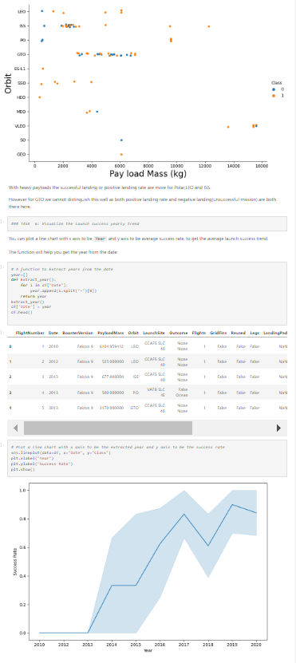
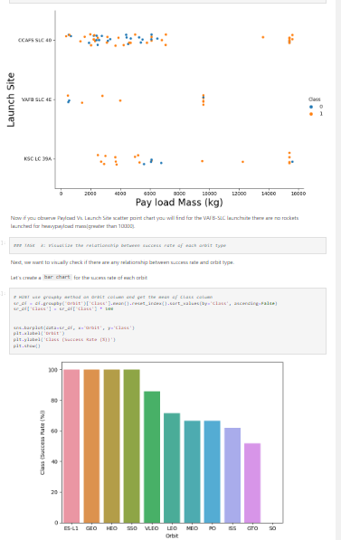
EDA with Data Visualization

Slide 13
EDA with SQL
The SQL Commands were used to
Display the names of the unique launch sites in the space mission
Display 5 records where launch sites begin with the string 'CCA‘
Display the total payload mass carried by boosters launched by NASA (CRS)
Display average payload mass carried by booster version F9 v1.1
GitHub Link: https://github.com/AaratrikaSantra/Applied_Data_Science_Capstone/blob/main/5.%20EDA%20with%20Visualization%20Lab%20Space%20X%20Falcon%209.ipynb

Slide 14
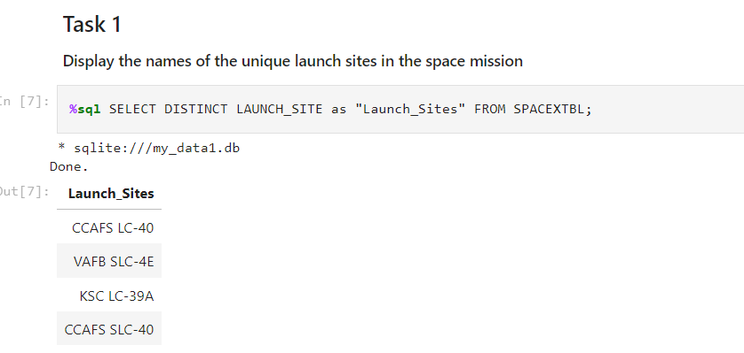
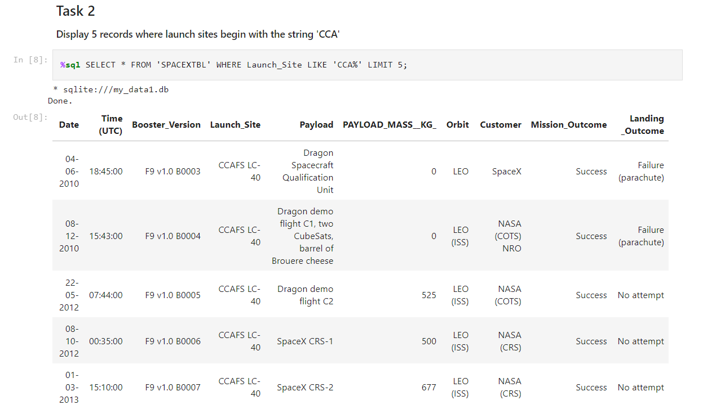
EDA with SQL

Slide 15
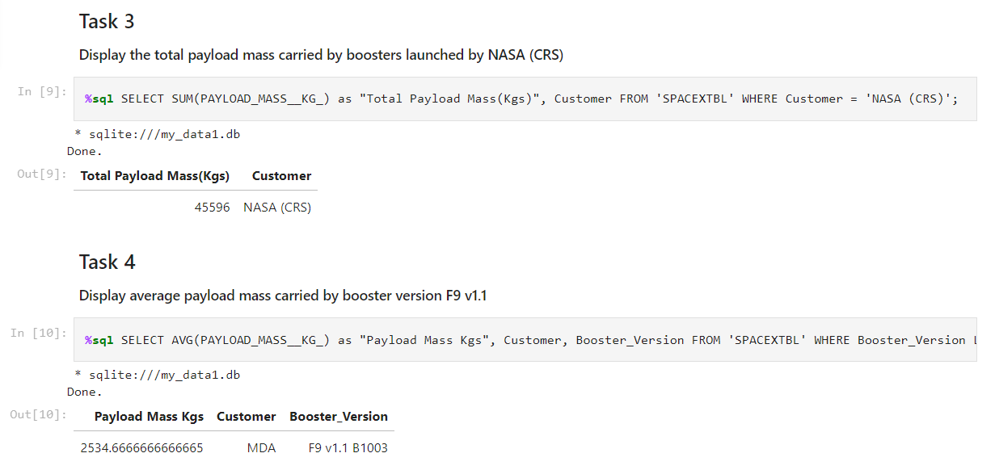
EDA with SQL

Slide 16
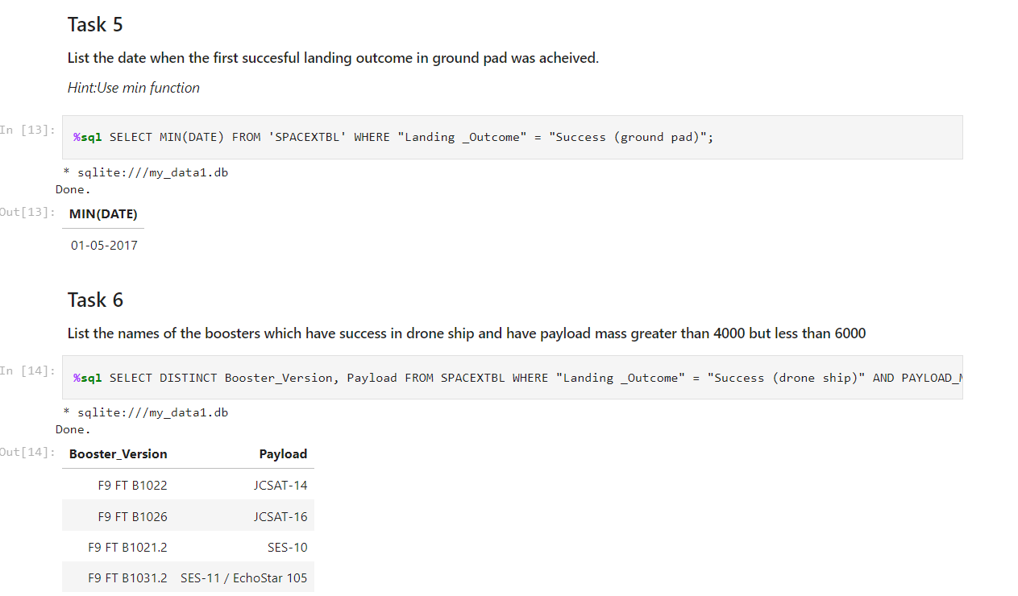
EDA with SQL

Slide 17
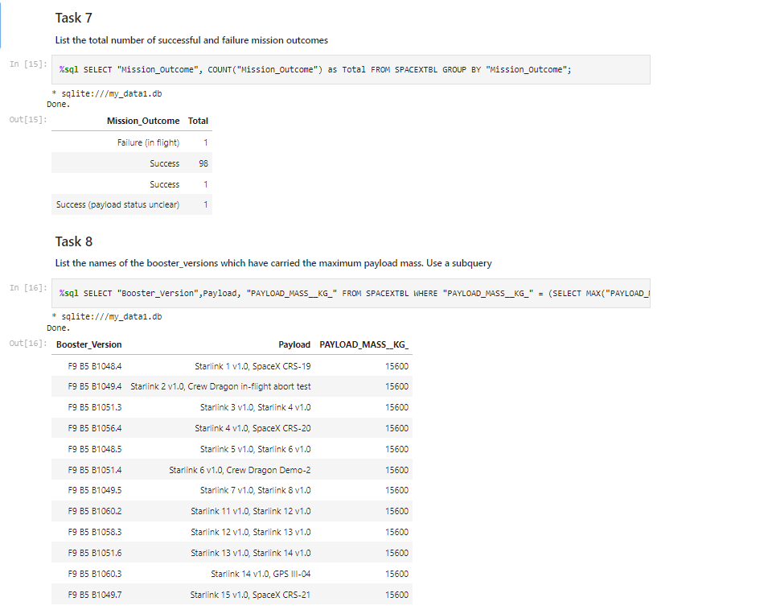
EDA with SQL

Slide 18
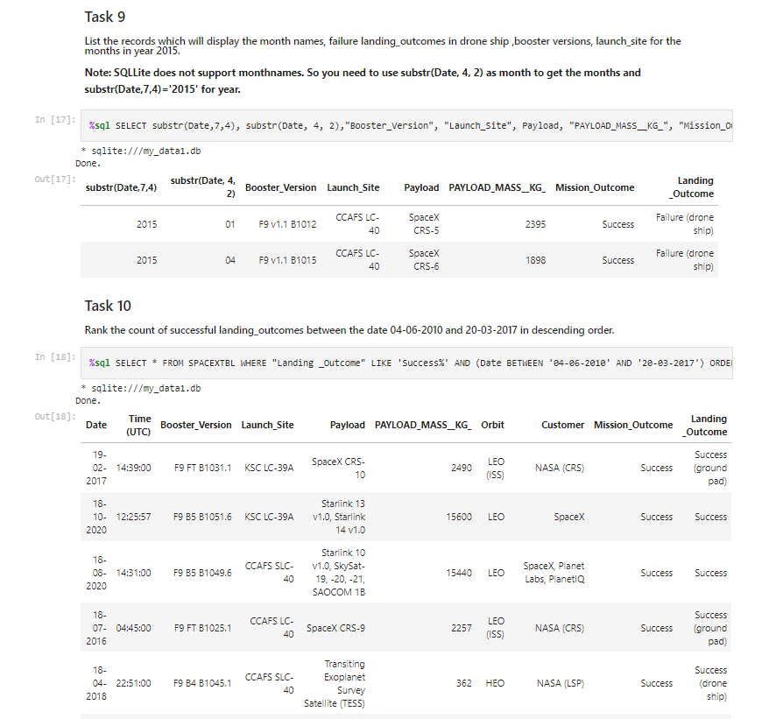
EDA with SQL

Slide 19
Build an Interactive Map with Folium
Created folium map to marked all the launch sites, and created map objects such as markers, circles, lines to mark the success or failure of launches for each launch site.
Created a launch set outcomes (failure=0 or success=1). We use this to determine success and failure overall.
GitHub Link: https://github.com/AaratrikaSantra/Applied_Data_Science_Capstone/blob/main/6.%20Launch%20Sites%20Locations%20Analysis%20with%20Folium.ipynb

Slide 20
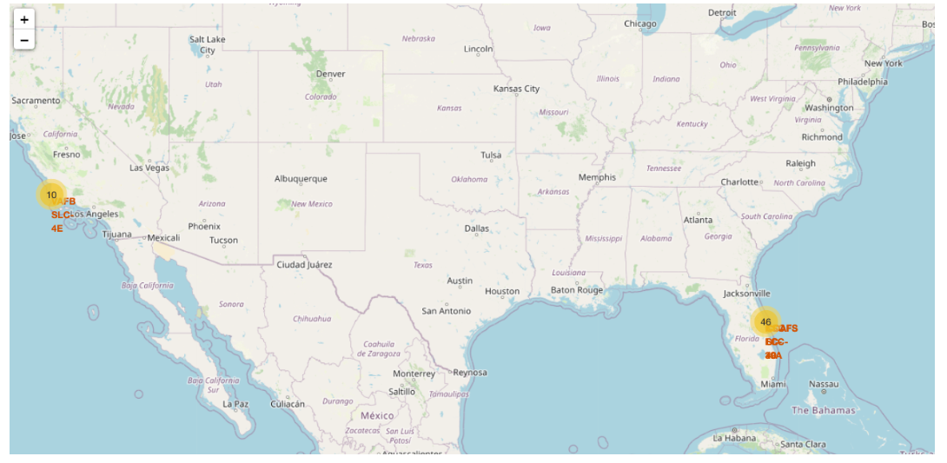
Build an Interactive Map with Folium

Slide 21
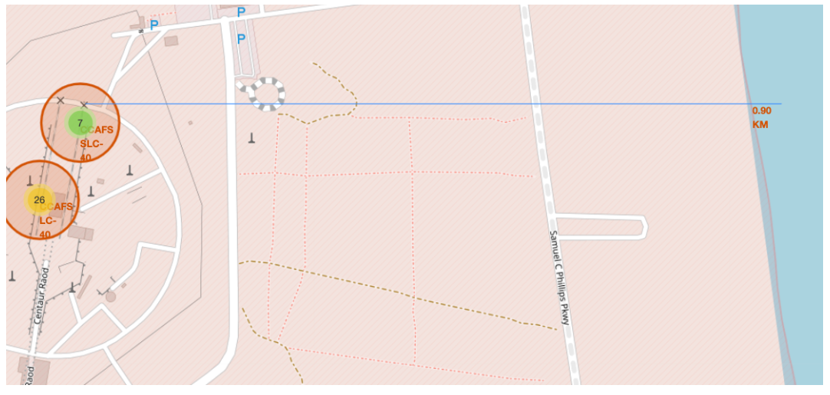
Build an Interactive Map with Folium

Slide 22
Build a Dashboard with Plotly Dash
Built an interactive dashboard application with Plotly dash by:
Adding a Launch Site Drop-down Input Component
Adding a callback function to render success-pie-chart based on selected site dropdown
Adding a Range Slider to Select Payload
Addeng a callback function to render the success-payload-scatter-chart scatter plot
GitHub Link: https://github.com/AaratrikaSantra/Applied_Data_Science_Capstone/blob/main/7.%20Interactive%20Dashboard%20with%20Ploty%20Dash.py

Slide 23
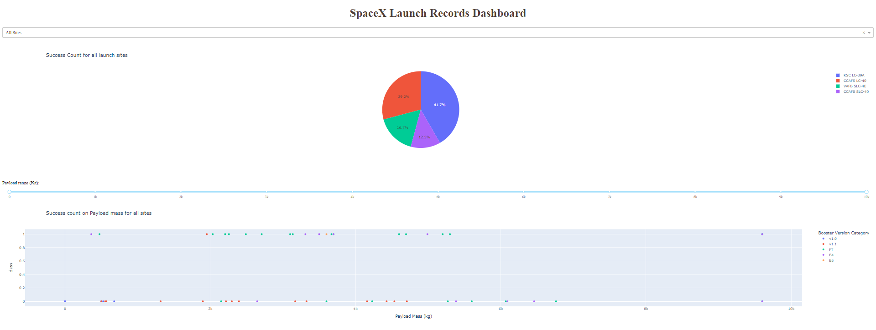
Build a Dashboard with Plotly Dash

Slide 24
Predictive Analysis (Classification)
Summary of building, evaluating, improving, and finding the best performing classification model
After loading the data as a Pandas Dataframe, perform exploratory Data Analysis and determine Training Labels
GitHub Link: https://github.com/AaratrikaSantra/Applied_Data_Science_Capstone/blob/main/8.%20Machine%20Learning%20Prediction.ipynb

Slide 25
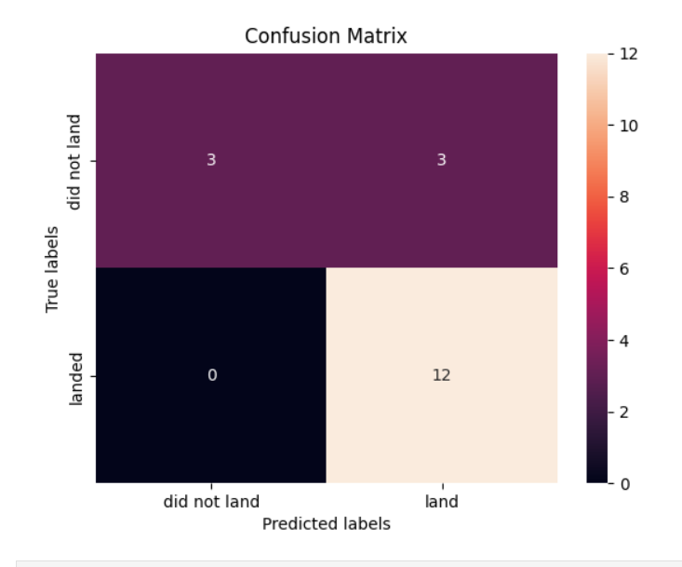
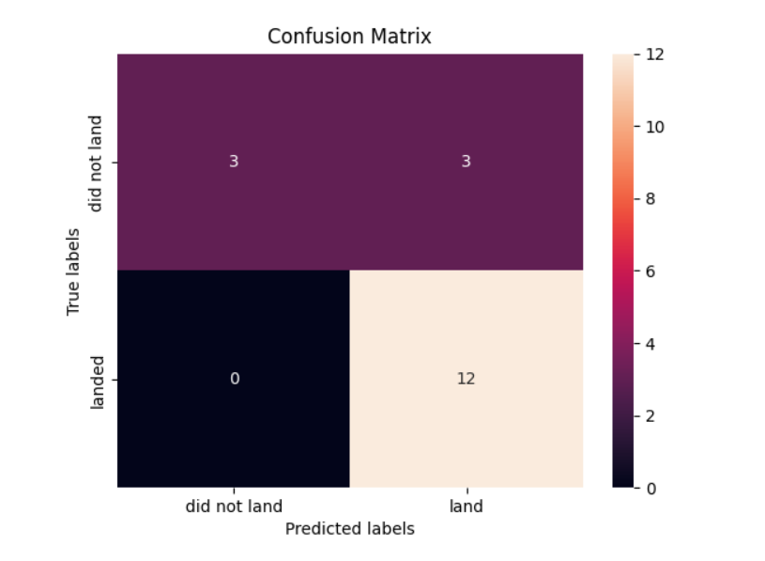
Predictive Analysis (Classification)

Slide 26
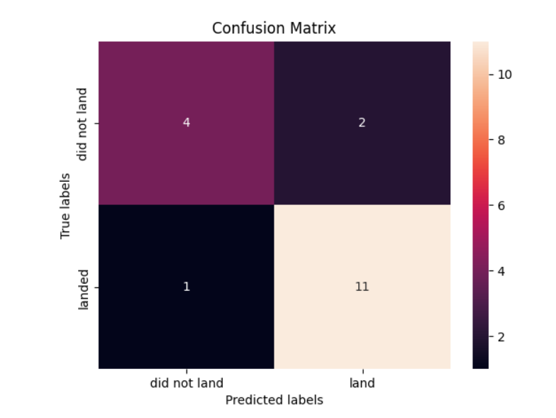
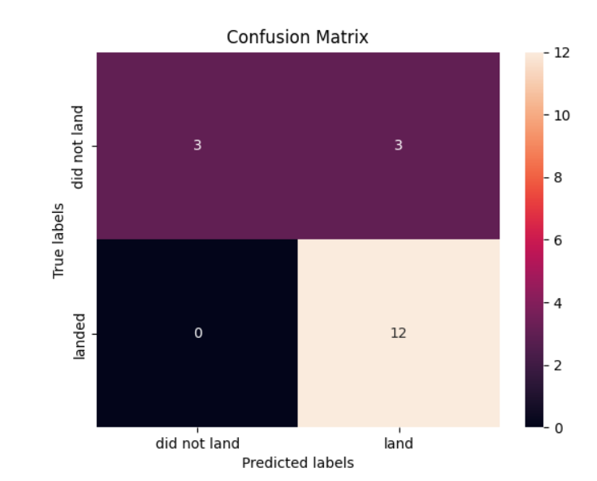
Predictive Analysis (Classification)

Slide 27
Results
Exploratory data analysis results
Interactive analytics demo
Predictive analysis results

Slide 28

Section 2

Slide 29
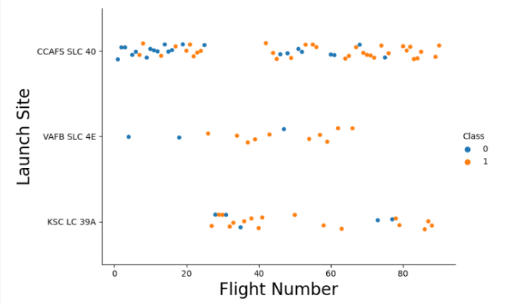
Flight Number vs. Launch Site

Slide 30
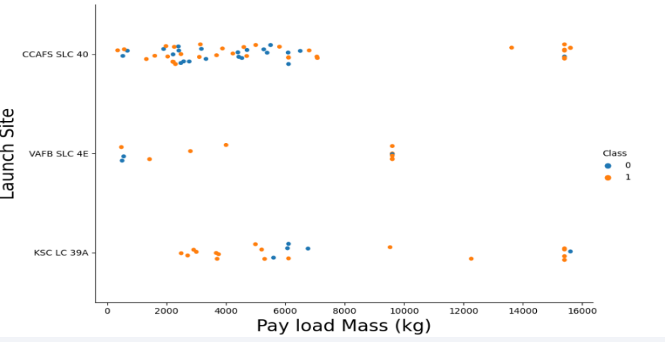
Payload vs. Launch Site

Slide 31
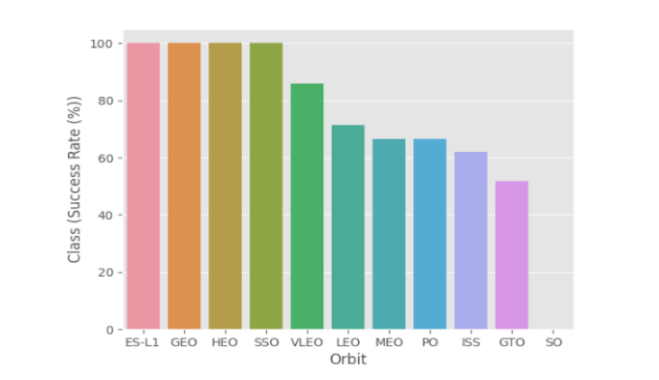
Success Rate vs. Orbit Type

Slide 32
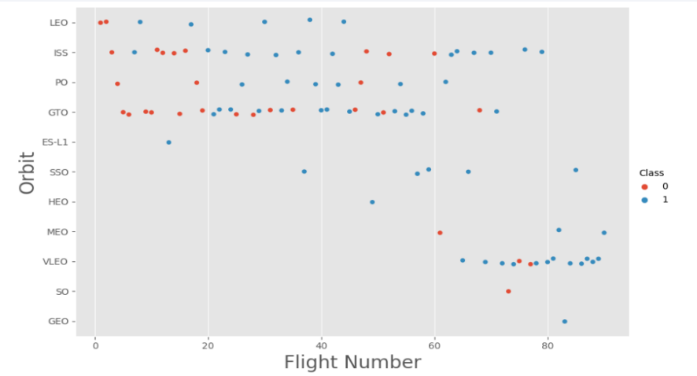
Flight Number vs. Orbit Type

Slide 33
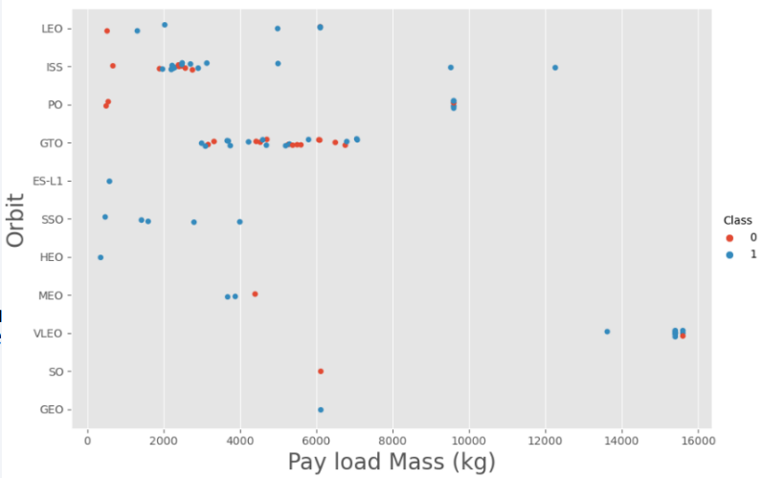
Payload vs. Orbit Type

Slide 34
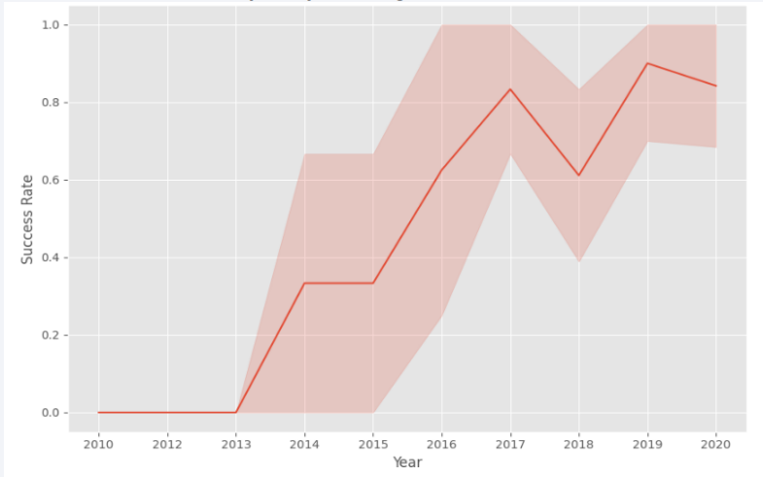
Launch Success Yearly Trend

Slide 35
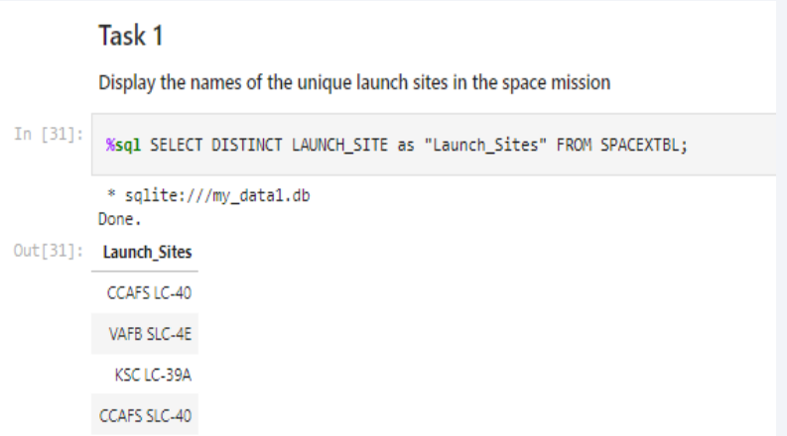
All Launch Site Names

Slide 36
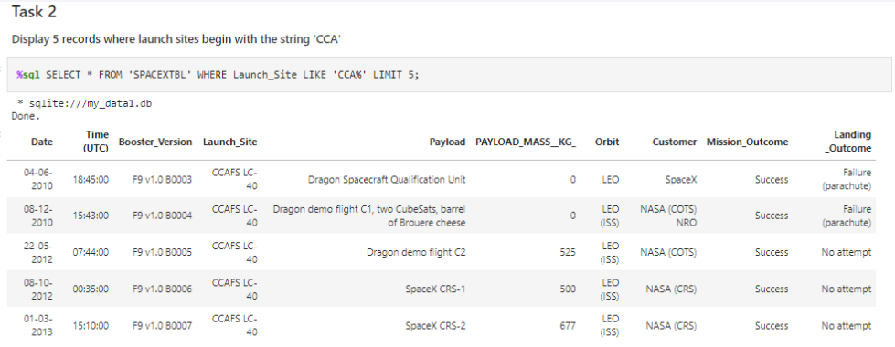
Launch Site Names Begin with 'CCA'

Slide 37
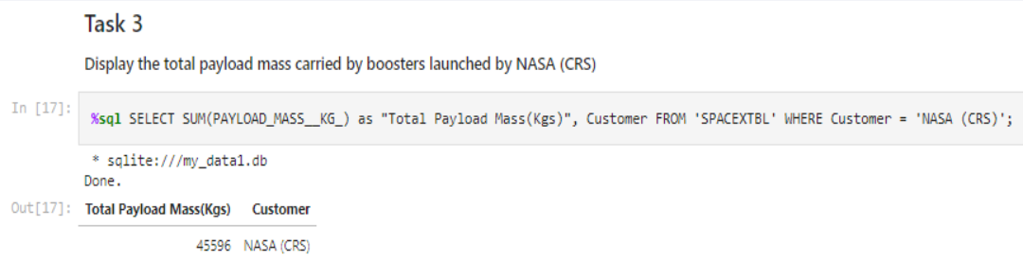
Total Payload Mass

Slide 38
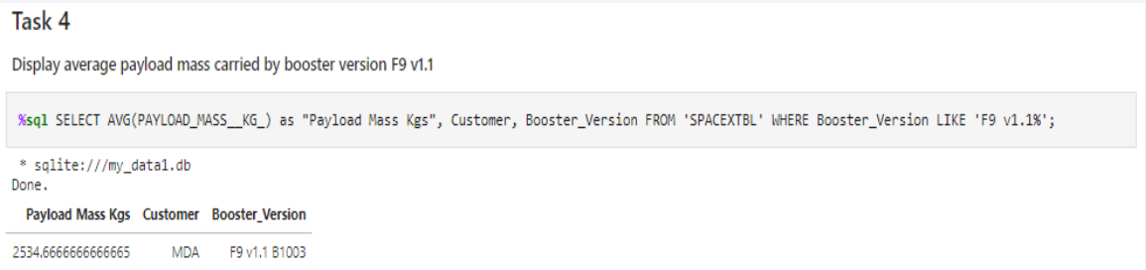
Average Payload Mass by F9 v1.1

Slide 39
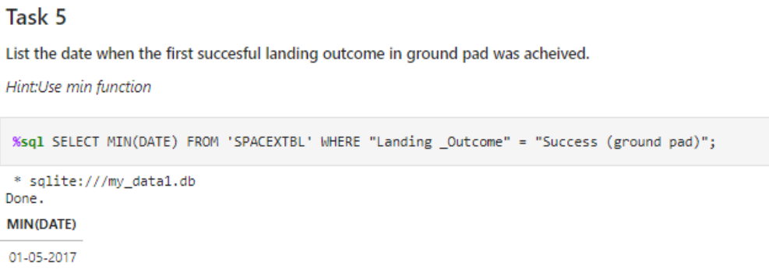
First Successful Ground Landing Date

Slide 40
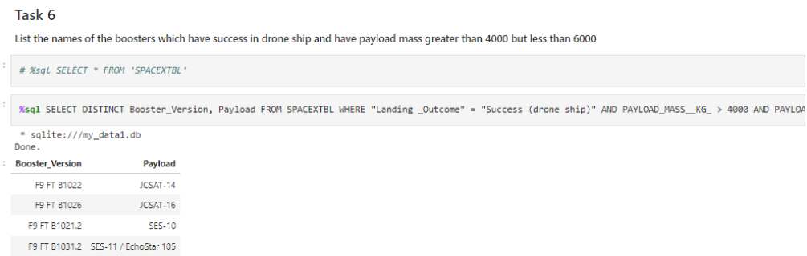
Successful Drone Ship Landing with Payload between 4000 and 6000

Slide 41
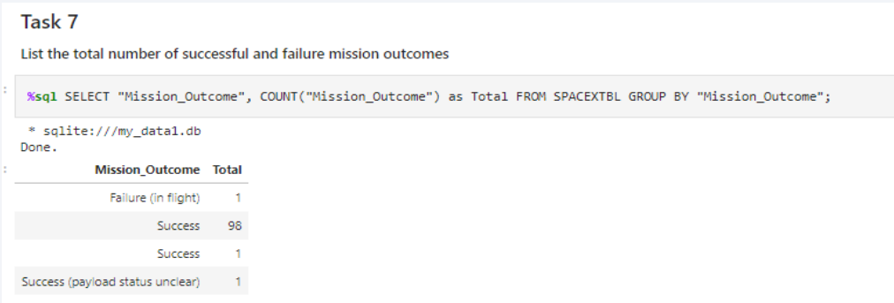
Total Number of Successful and Failure Mission Outcomes

Slide 42
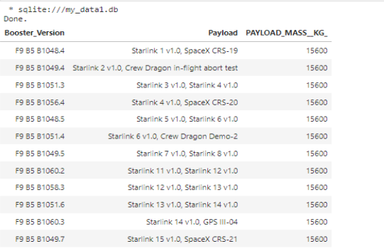
Boosters Carried Maximum Payload

Slide 43
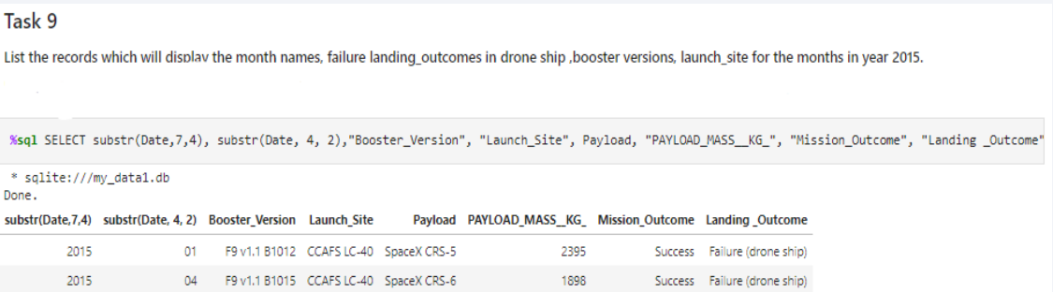
2015 Launch Records

Slide 44
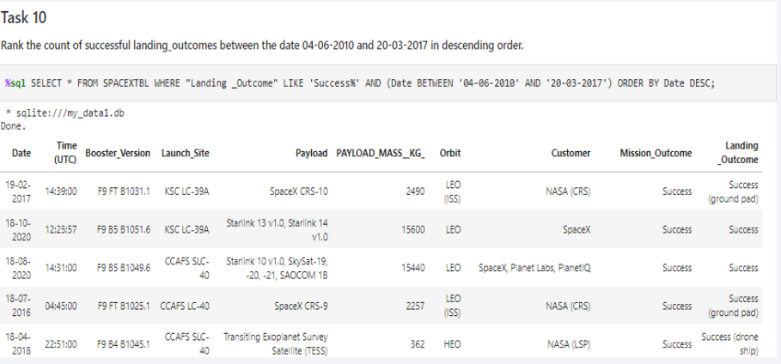
Rank Landing Outcomes Between 2010-06-04 and 2017-03-20

Slide 45

Section 3

Slide 46
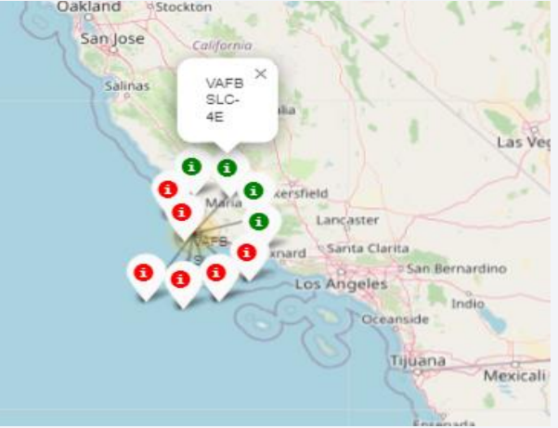
Launch outcomes for each site on the map With Color Markers

Slide 47
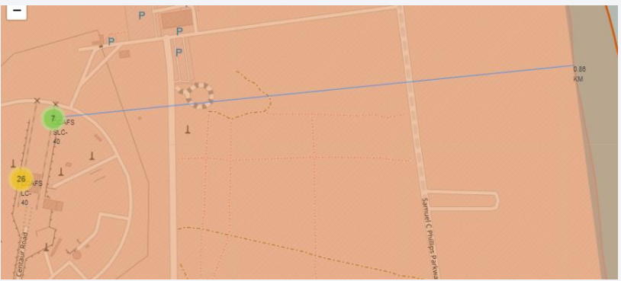
Distances between a launch site to its proximities

Slide 48
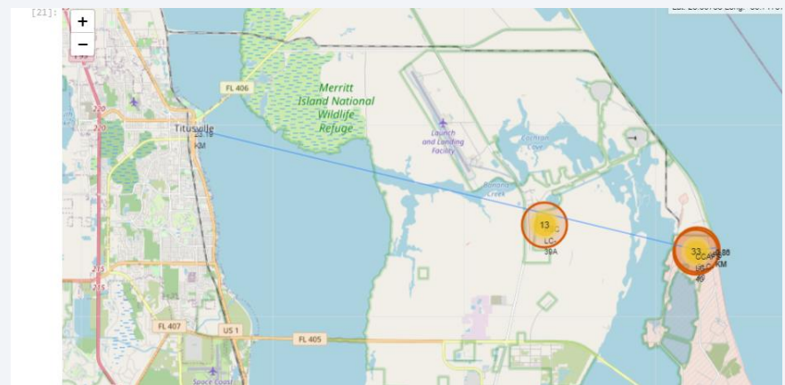
Distances between a launch site to its proximities

Slide 49

Section 4

Slide 50
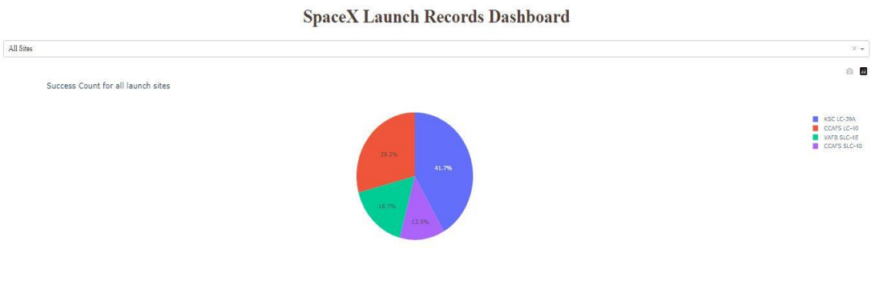
Pie-Chart for launch success count for all site

Slide 51
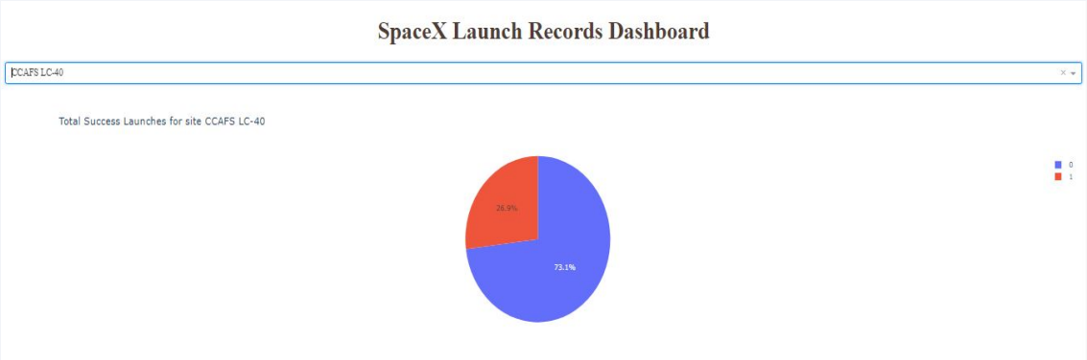
Pie chart for the launch site with 2 nd highest launch success ratio

Slide 52
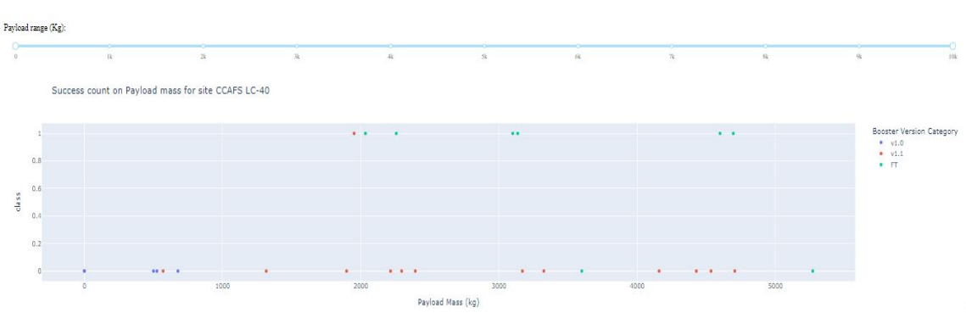
Payload vs. Launch Outcome scatter plot for all sites

Slide 53

Section 5

Slide 54
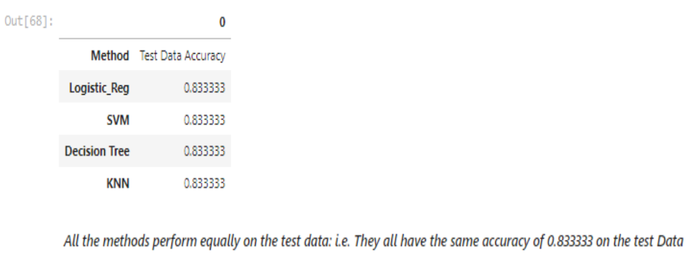
Classification Accuracy

Slide 55
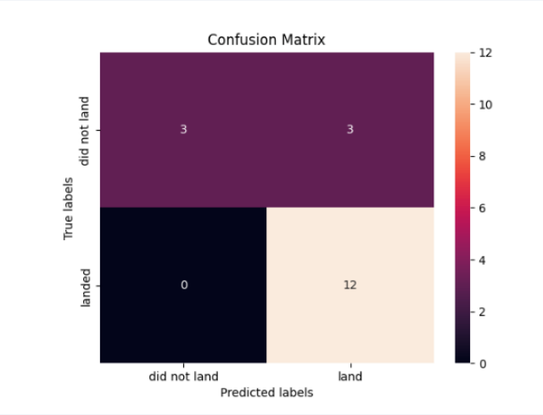
Confusion Matrix
All the 4 classification model had the same confusion matrixes and were able equally distinguish between the different classes.

Slide 56
Conclusions
Different launch sites have different success rates. CCAFS LC-40, has a success rate of 60 %, while KSC LC-39A and VAFB SLC 4E has a success rate of 77%.
We can deduce that, as the flight number increases in each of the 3 launch sites, so does the success rate.
Payload Vs. Launch Site scatter point chart you will find for the VAFB-SLC launchsite there are no rockets launched for heavypayload mass(greater than 10000).

Slide 57


